Slide 2
What Will Be Covered:
Services Offered
Tuition and Fees Payment Options
Eagle Express Tuition Plan
How to Receive a Refund
FERPA
Important Reminders

Slide 3


STUDENT ACCOUNTING AND UNIVERSITY CASHIERING SERVICES (SAUCS)
Where are we?
Eagle Student Services Center (ESSC)
1st floor
What hours?
8:15am-5:00pm M-F
Or Online!
www.studentaccounting.unt.edu
Student.Accounting@unt.edu
Reach us by Phone
940.565.3225

Slide 4
What services do we offer?
Assessment and tuition and fee payments
Installment Payment plans
Award Short-Term Loans to extend the first payment deadline
Waivers, exemptions, third-party billing
ID cards for students, faculty, & staff
Refunds

Slide 5
Methods of Payment
Payment can be made online at my.unt.edu
eChecks (online check payments) and credit/debit card payments are accepted
Credit and debit card transactions will be charged a 2.7% fee
Use the eCheck option to avoid additional fees

Slide 6
Cashiering Services
Methods of Payment
SAUCS accepts checks, cash, money orders, and cashier’s checks
Debit or credit card payments are only accepted online

Slide 7
OTHER PAYMENT OPTIONS
The Installment Plan
Available in the Fall and Spring
Students enroll in the plan online.
Offers 4 payments, with 1st installment of 10% of student account balance, plus $20 plan fee due at time of enrollment
The remaining 3 payments for Spring 2018 are due, February 3rd, March 3rd and April 3rd

Slide 8
OTHER PAYMENT OPTIONS
Short-Term Loan
Provides extension of the payment deadline
Additional information and application available online at http://studentaccounting.unt.edu/short-term-loans
Loan will be applied to student account and can be useful when awaiting financial aid award

Slide 9
Important Note: Financial Aid regulations prohibit federal financial aid from paying the following charges:
Installment plan charge, Short Term Loan Origination Fee, Memorial Loan fee, Late payment or default fees
Excess hours tuition fee
Repeat course fee
** Once federal financial aid has paid tuition, fees and housing (if applicable), some students may receive a refund yet still owe a balance cause of finance and/or overtime charges. Payment arrangements would need to be made for the remaining balance to secure a student’s classes **

Slide 10
Waivers, Exemptions, and
Third Party Billing
Waivers & Exemptions
Waives or exempts (through financial assistance) a portion or all of a student’s tuition and/or fees
For questions or more information, visit www.collegeforalltexans.com
Third Party Billing
Texas Guaranteed Tuition Plan (formerly Texas Tomorrow Fund)
Texas Tuition Promise Fund
Other Sponsored billing

Slide 11

Eagle Express Tuition Plan

Slide 12
What is the Eagle Express Tuition Plan?
A fixed rate tuition plan for incoming freshmen or transfer students (Texas Residents)
Remains active for 4 years (12 consecutive semesters that occur after the date of the student’s initial enrollment).
Locks in total academic costs until a student graduates or up to 4 years from initial enrollment in the plan, whichever comes first.
An opportunity to receive an incentive of up to $3,000 for students who complete their degrees and meet eligibility requirements (calculated in the student’s last 15 credit hours before graduation).

Slide 13
Transfer credits
Eligibility for the graduation incentive for students is based on the number of hours taken at UNT. The number of credits transferred to UNT determines the incentive amount and the required graduation timeframe. Students with greater than 60 transfer hours will likely not be eligible for the graduation incentive and therefore should carefully consider if the Traditional Tuition plan is the best option for them.
Transfer Credits | Eagle Express Graduation incentive amount | To qualify, student must graduate in no more than :
12 hours or fewer | $3,000 | 4 years
13-30 hours | $2,000 | 3 years
31-60 hours | $1,000 | 2 years

Slide 14
Eagle Express - How to Opt in or Out
Once tuition and fee bill is available, go to my.unt.edu to view the bill. Information for electing Eagle Express will be presented at that time.
New students are provided one opportunity to elect Eagle Express. If student does not opt-in, student will remain in the traditional tuition program for future enrollment.

Slide 15
BankMobile Vibe
UNT refunds are processed by BankMobile Vibe, an outside vendor, to allow for efficient processing of refunds.
After new students register for 6 or more credit hours, BankMobile Vibe account information will be mailed to their mailing address listed on the my.unt.edu student portal.

Slide 16
What should I do when I receive the card?
Go to refundselection.com to select a refund preference.
Why?
Selecting a refund preference ensures that refunds are received on-time. DON’T DELAY YOUR REFUND!
3 options for refund preference:
Have funds deposited to your BankMobile Vibe card. At this time a card will be sent to you to use it as a bank account.
Have funds deposited to a pre-established bank account.
Have a paper check mailed to the student (takes longer to receive refund).
As you can see, you need BankMobile Vibe to receive your refund!

Slide 17
FERPA
Family Educational Rights and Privacy Act of 1974
FERPA gives certain rights to parents regarding their children's educational records
Rights transfer to the student upon reaching 18 years of age or attending any school beyond the secondary (high school) level.
SAUCS is unable to share any financial information
For information, go to http://registrar.unt.edu/faculty/ferpa-and-student-records and contact the Registrar’s office.

Slide 18
Important Reminders
Check your my.unt.edu frequently
Keep your contact information up to date
If you change your schedule, after all Financial Aid has disbursed and refunded, you will have to pay any balance due
Your classes will be cancelled if your balance is not paid by the payment due date

Slide 19
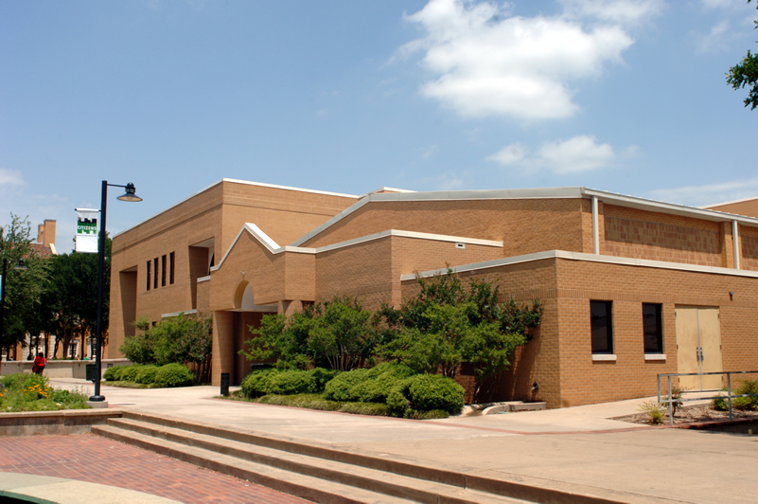
Thank you for choosing UNT!
Representatives are available after this presentation to answer any questions you may have.

